Slide 1

Healthcare Analytics Report
Simulating a healthcare analytics environment using a synthetic dataset inspired by Electronic Health Records (EHR).

Slide 2
Project Overview
Unlocking Insights from Healthcare Data
This project analyzes patient encounters, diagnoses, procedures, clinical observations, and payments to derive meaningful insights for hospital operations and patient care.

Slide 3
Project Goals
Domain Concepts
SQL for Business
Work with core healthcare domain concepts.
Write SQL for business-driven questions.
Data Flow
Apply Analytics
Understand data flow across encounters, diagnoses, procedures, and payments.
Apply analytics for operational and financial improvements.

Slide 4
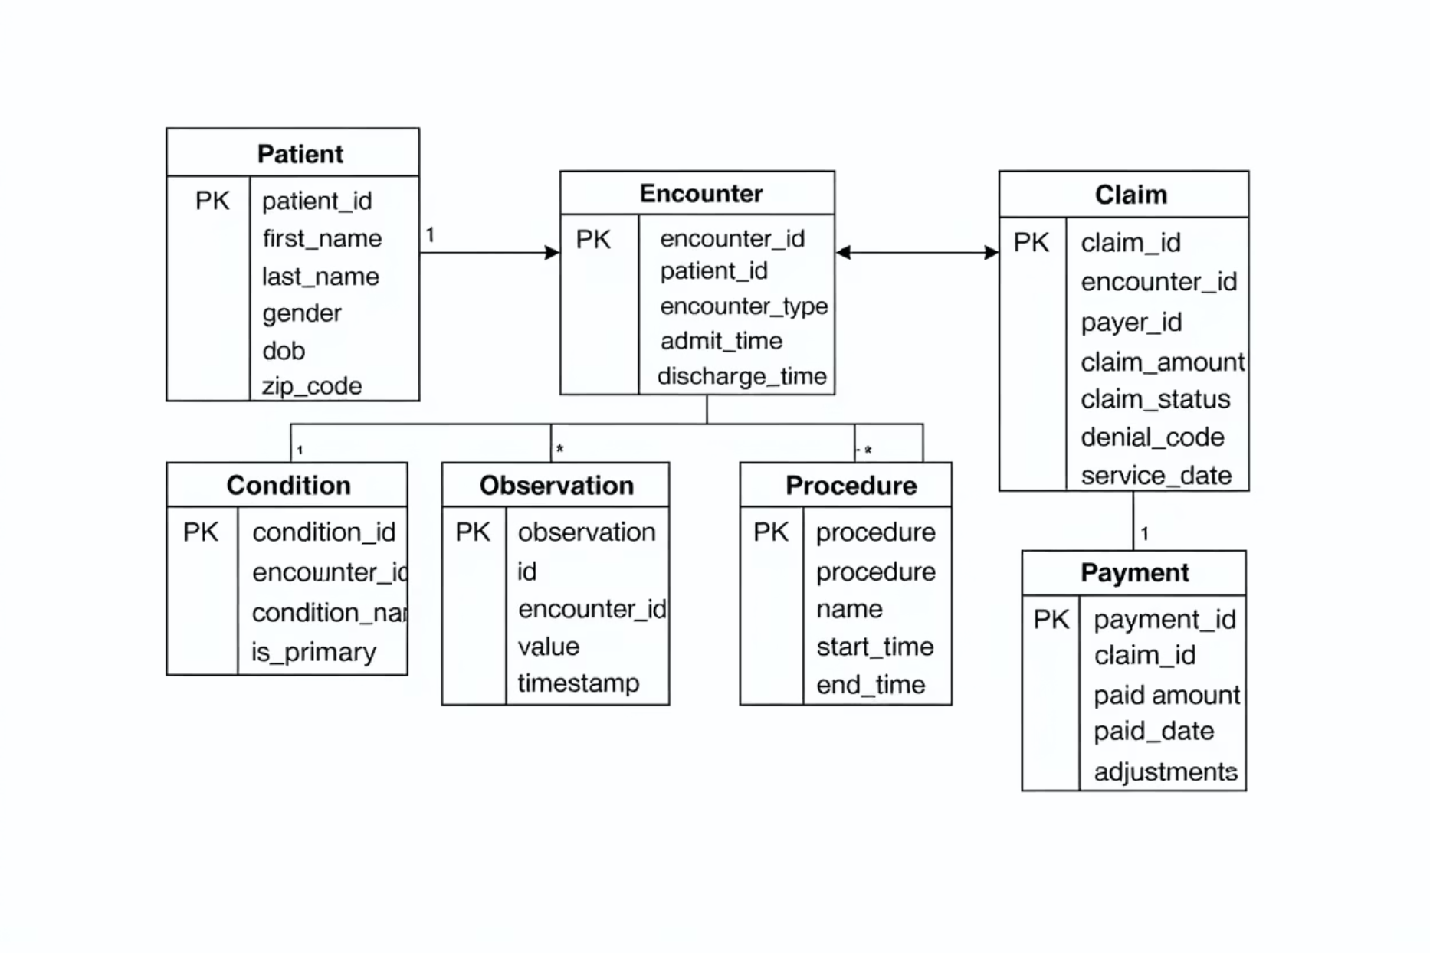
ER Diagram and Data Model
The project is structured around core healthcare concepts, illustrating relationships among entities like Patient, Encounter, Condition, Observation, Procedure, Claim, Payment, and Payer.

Slide 5
Key Business Questions
Operational & Financial Insights
We address critical questions to enhance hospital efficiency and patient care.

Slide 6
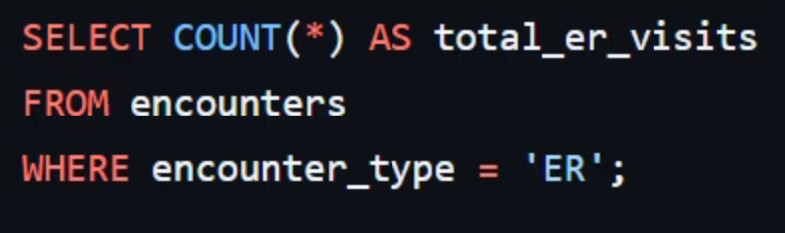
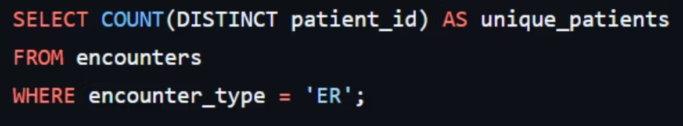
ER Visit Analysis
Total ER Visits
Unique ER Patients
Average ER Length of Stay (LOS)
SELECT AVG(TIMESTAMPDIFF(HOUR, admit_timestamp, discharge_timestamp)) FROM encounters WHERE encounter_type = 'ER';

Slide 7



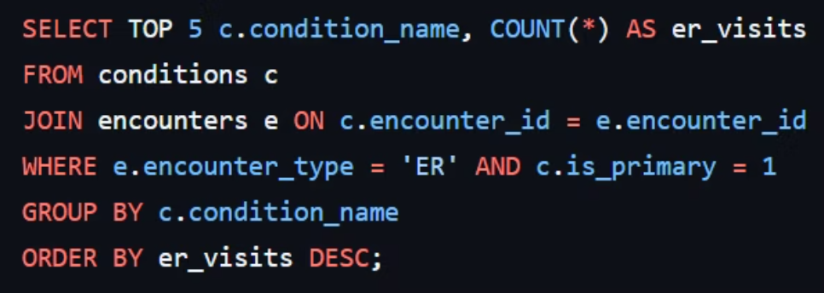
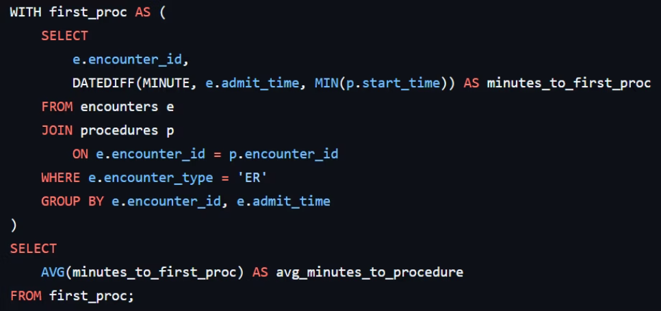
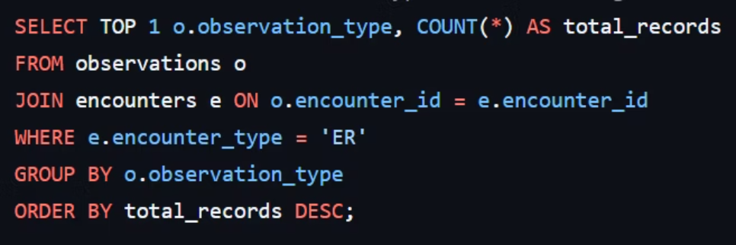
Clinical Insights
Top 5 Primary Conditions for ER Visits
Average Time: Admission to First Procedure
Most Common Observation Type in ER
Identify the most frequent primary diagnoses associated with ER visits.
Measure the average duration between patient admission and their initial procedure.
Determine the most frequently recorded observation type during ER encounters.

Slide 8
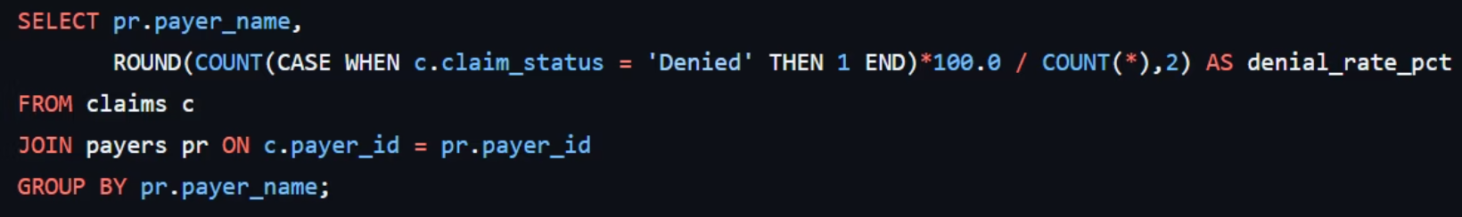
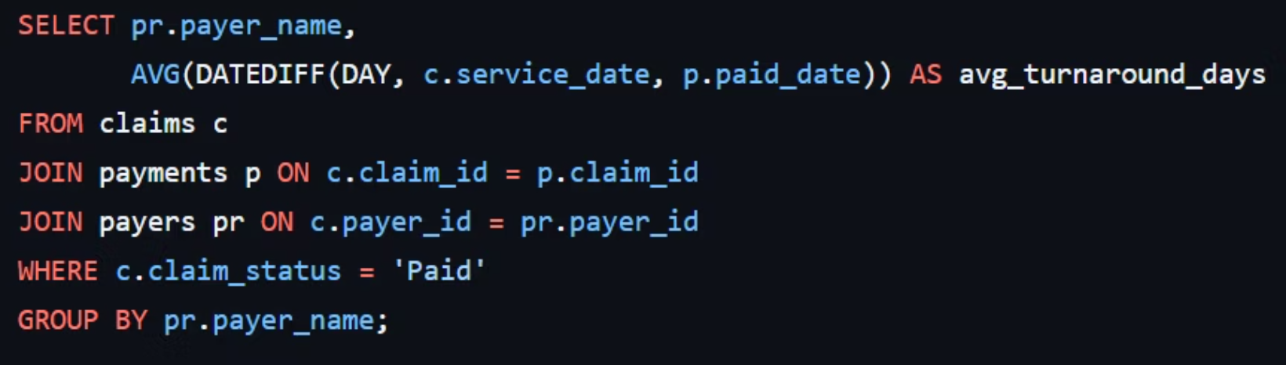
Financial Performance
Claim Denial Rate by Payer
Average Payment Turnaround (Days) per Payer

Slide 9
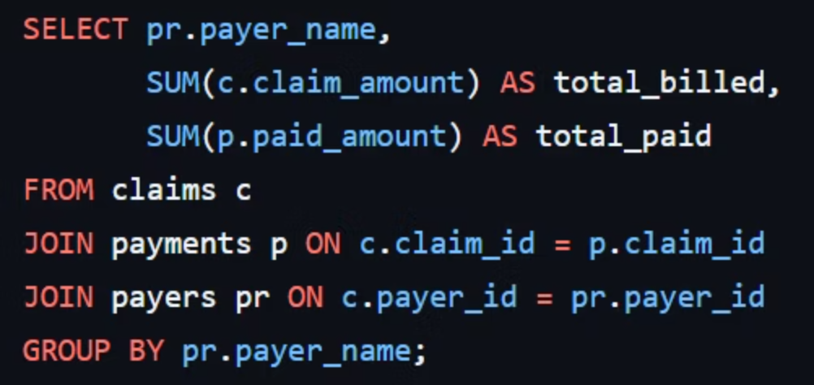
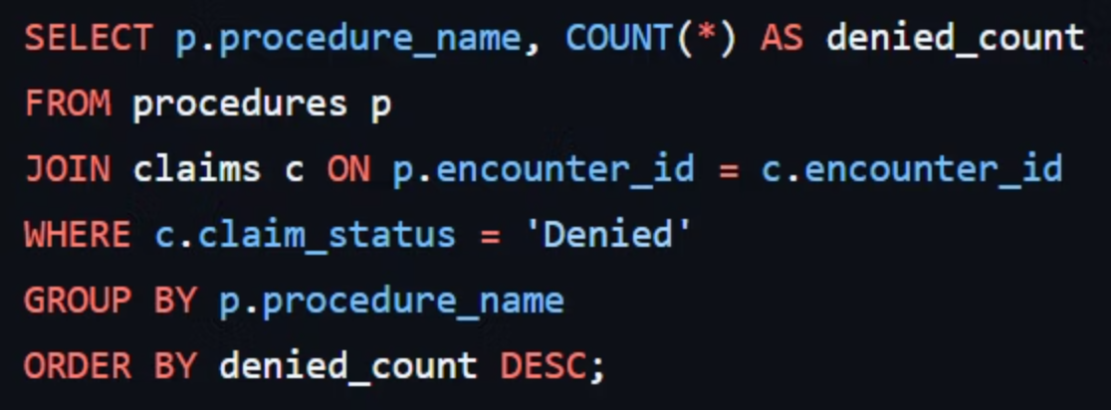
Billing & Denials
Total Billed vs. Total Paid per Payer
Most Denied Procedure Codes

Slide 10

Conclusion
Driving Better Healthcare Outcomes
By leveraging data analytics, we can optimize hospital operations, improve patient care, and enhance financial performance.

